Slide 1


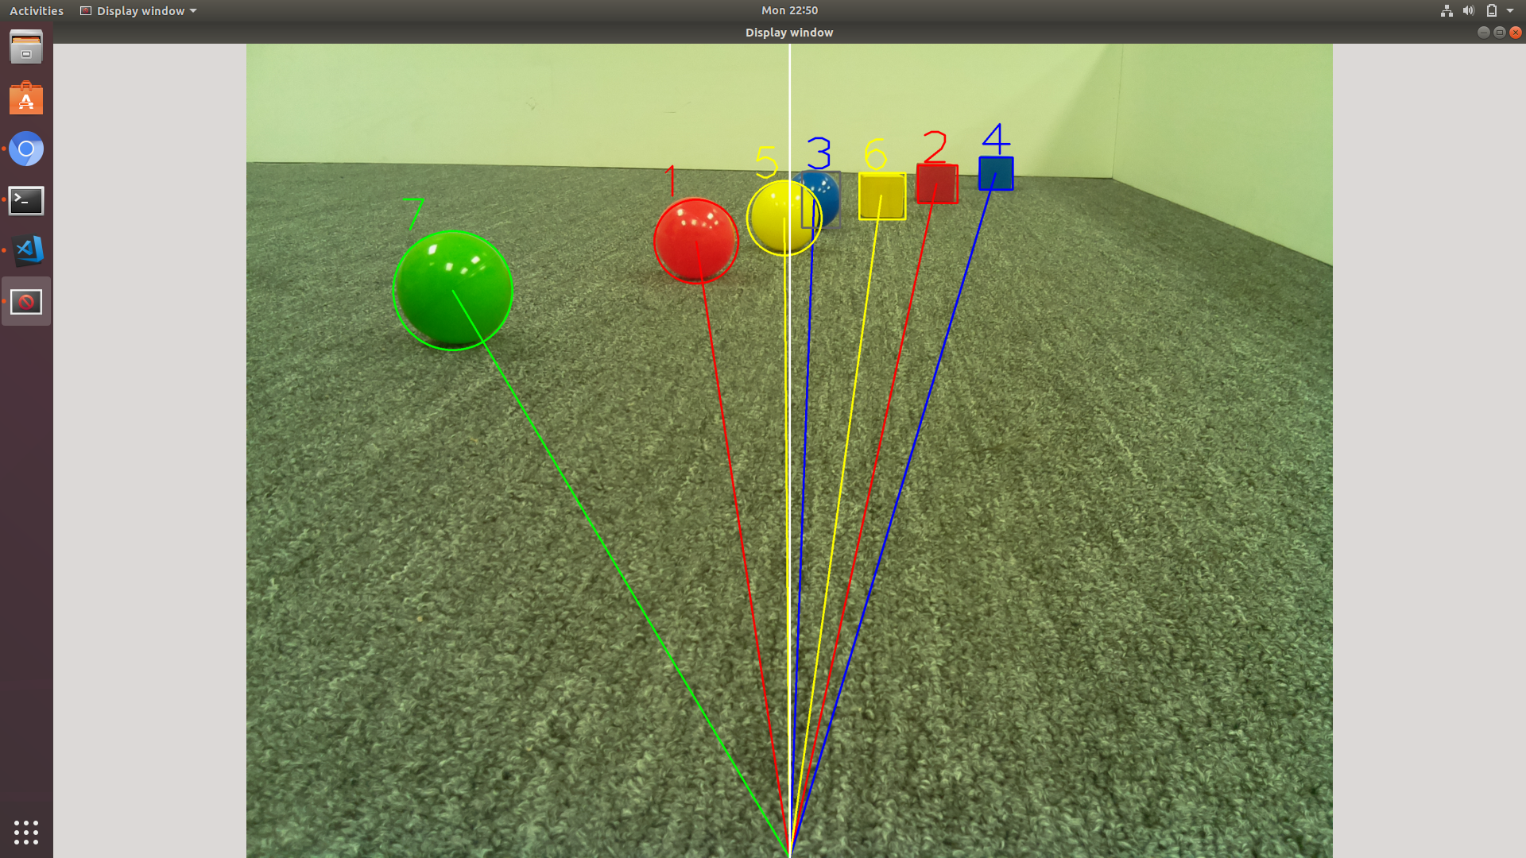
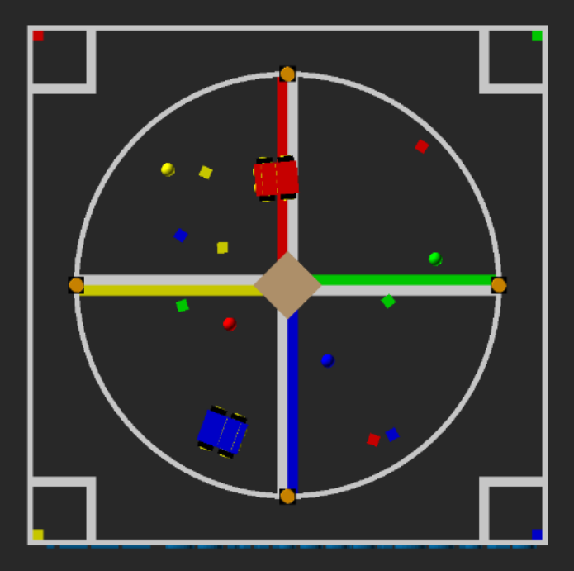
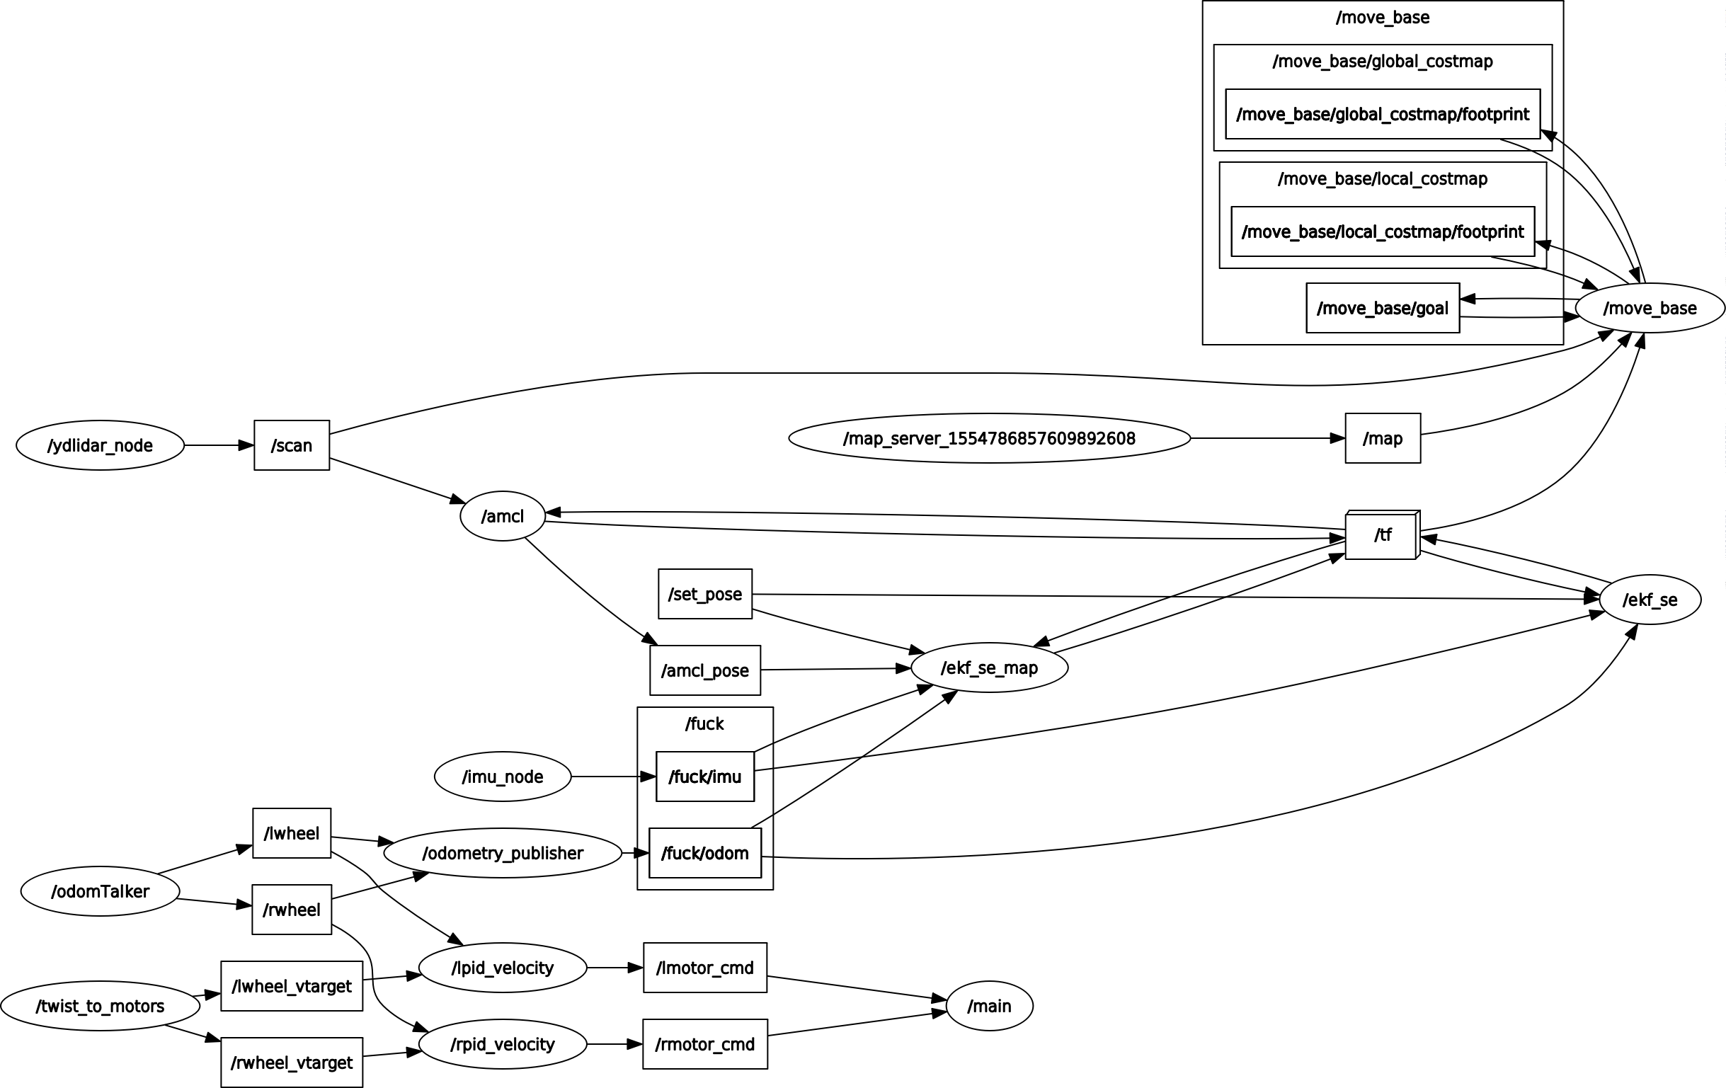
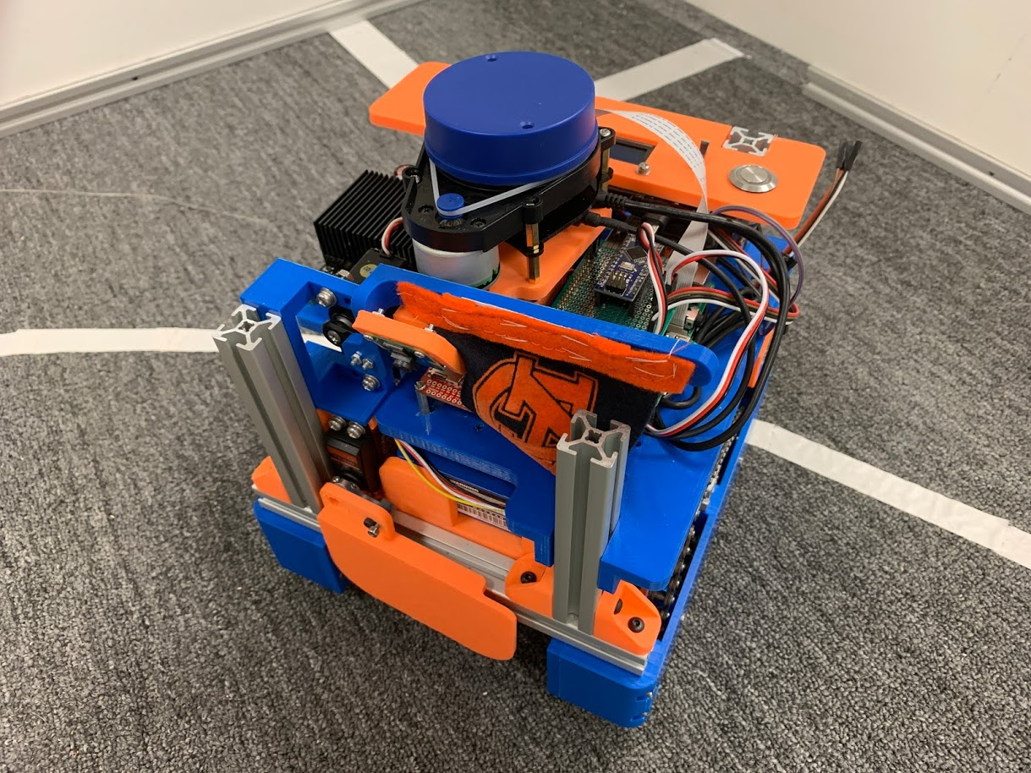
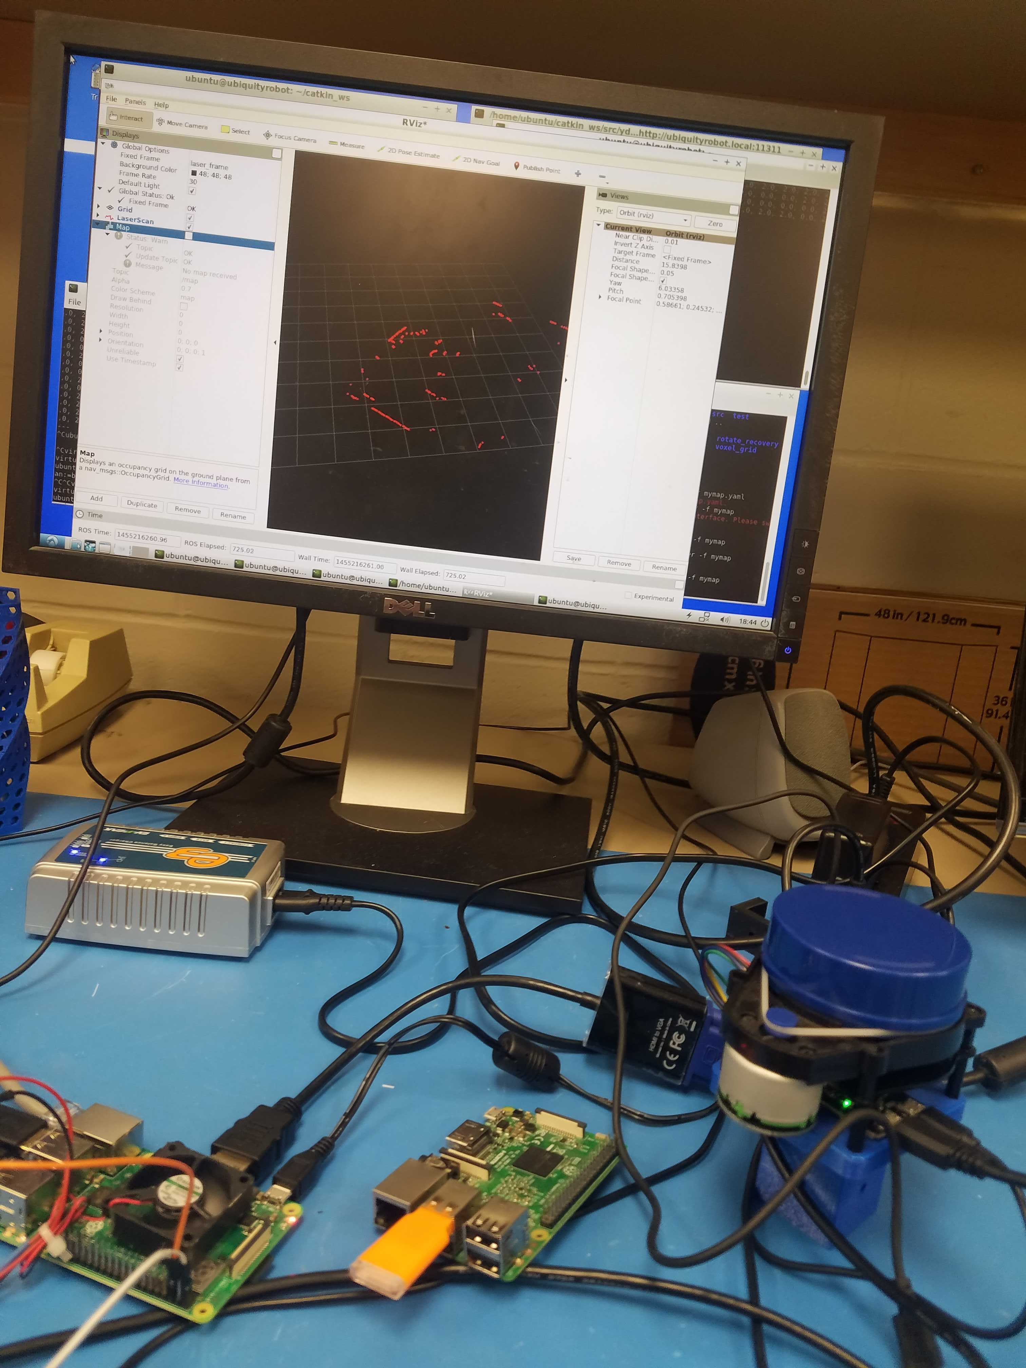
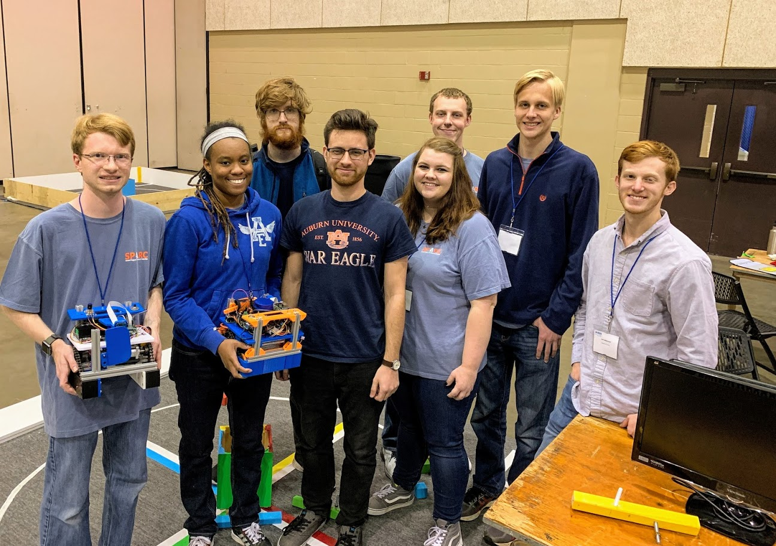
IEEE SoutheastCon 2019 Hardware Competition Team
Objective
Electrical Hardware:
Navigation:
Construct autonomous mobile robot to compete in 3 minute round
Scoring Criteria
5 points for leaving home base
10 points for returning to home base
25 points for raising flag
Up to 15 points per cube move to colored corner
5 points per revolution around center
ROS:
Lessons Learned
Technical Approach
Mechanical:
Localization:

